Slide 1

Introduction to Pizza Sales Analysis
Overview: This presentation provides an in-depth analysis of pizza sales data, covering the entire process from data collection to uncovering key insights.
Key Topics: - Data Collection and Preprocessing - Exploratory Data Analysis - SQL Queries for Data Manipulation - Python Libraries for Data Analysis - Visualizing Sales Trends - Identifying Key Insights - Conclusion and Recommendations
Photo by Brenna Huff on Unsplash

Slide 2

Data Collection and Preprocessing
Data Gathering: Collect relevant data from sales records, customer orders, and other sources to build a comprehensive dataset.
Data Cleaning: Clean and standardize the data, addressing any inconsistencies, missing values, or outliers.
Feature Engineering: Create new variables and features that can provide additional insights into the data.
Photo by Digitawise Agency on Unsplash

Slide 3
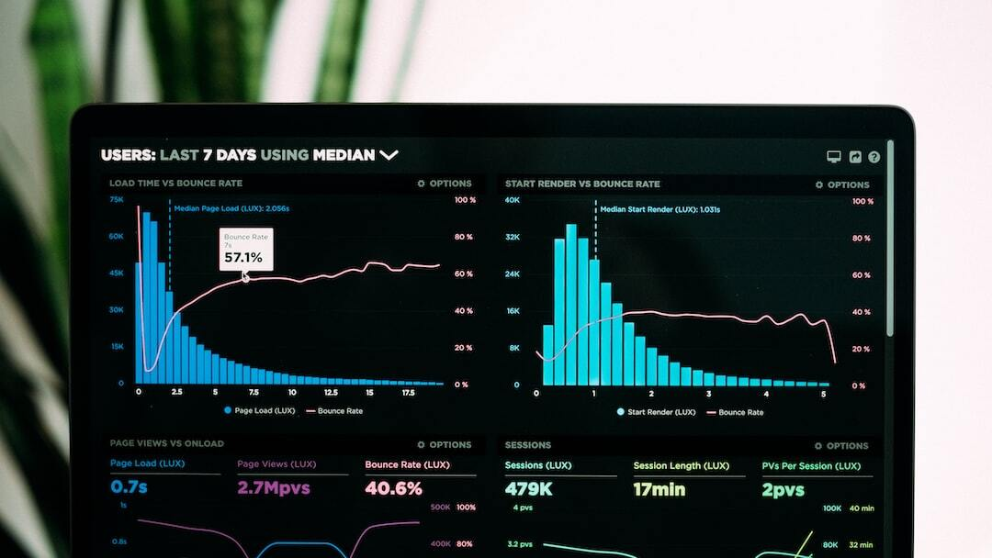
Exploratory Data Analysis
Understanding the Data: Examine the distribution, patterns, and relationships within the dataset to gain a deeper understanding of the pizza sales.
Identifying Trends: Analyze the data to uncover any seasonal variations, peak sales periods, or other trends that may impact business operations.
Detecting Anomalies: Identify any outliers or unusual data points that may require further investigation or explain certain sales patterns.
Photo by Luke Chesser on Unsplash

Slide 4

SQL Queries for Data Manipulation
Aggregating Data: Use SQL functions like SUM, AVG, and COUNT to summarize and group the data.
Filtering and Sorting: Apply filters and sorting to extract specific subsets of the data for further analysis.
Joining Tables: Combine data from multiple tables to create a more comprehensive dataset for analysis.
Data Manipulation: Perform advanced SQL operations, such as window functions and subqueries, to transform the data.
Photo by Markus Spiske on Unsplash

Slide 5

Python Libraries for Data Analysis
Pandas: Powerful data manipulation and analysis library.
NumPy: Efficient numerical computing and data structures.
Matplotlib: Comprehensive data visualization library.
Seaborn: Advanced statistical data visualization.
Photo by Ilija Boshkov on Unsplash

Slide 6

Visualizing Sales Trends
Sales by Month: Analyze monthly pizza sales to identify seasonal patterns and trends.
Sales by Day of Week: Understand how sales vary throughout the week and identify peak days.
Sales by Topping: Determine the most popular pizza toppings and how they influence sales.
Photo by Isaac Smith on Unsplash

Slide 7

Conclusion and Recommendations
Key Takeaways: Summarize the main findings and insights gained from the comprehensive pizza sales analysis.
Actionable Recommendations: Provide strategic recommendations based on the insights to help the business optimize its operations, increase profitability, and drive growth.
Next Steps: Outline the proposed plan for implementing the recommendations and continuing the data-driven decision-making process.
Photo by Kelly Sikkema on Unsplash

Slide 8
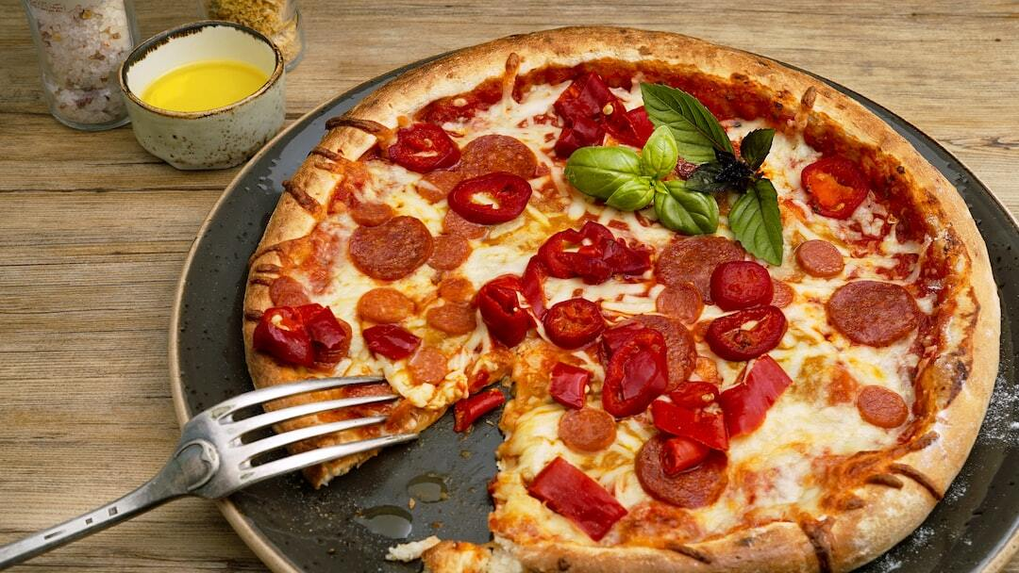
Conclusion and Recommendations
Key Takeaways: Summarize the main findings and insights gained from the comprehensive pizza sales analysis.
Actionable Recommendations: Provide strategic recommendations based on the insights to help the business optimize its operations, increase profitability, and drive growth.
Next Steps: Outline the proposed plan for implementing the recommendations and continuing the data-driven decision-making process.
Photo by Wesual Click on Unsplash

